Slide 1
PowerFlex Drive Conversion Tool
ROBERT CHENEY • DIGITAL EXPERIENCE, LVD

Slide 2



PowerFlex Drive Conversion Tool
Overview
Converts drive configuration files to PowerFlex 755TS CCW configuration files (.IUUX)
Supports conversion from the following drives
PowerFlex 755
PowerFlex 700 with Vector Control
DriveExecutive (.DNO)
POWERFLEX
DRIVE
CONVERSION
TOOL
POWERFLEX 755TS
CCW (.IUUX)
POWERFLEX 755 POWERFLEX 700
POWERFLEX 755TS
CCW (.IUUX)

Slide 3
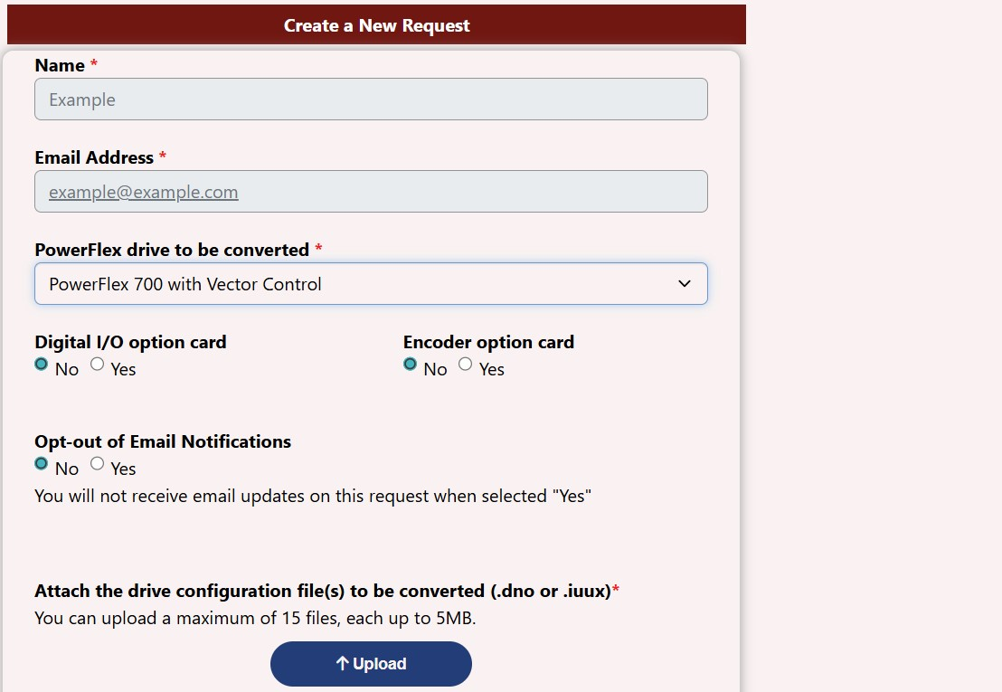
PowerFlex Drive Conversion Tool
Using the online tool
User login allows for accessing conversion history
Upload the original drive configuration
Up to 15 drive configuration files may be uploaded at once
For PowerFlex 700 with Vector Control, users can select if they need to include I/O option card and/or Encoder option card

Slide 4
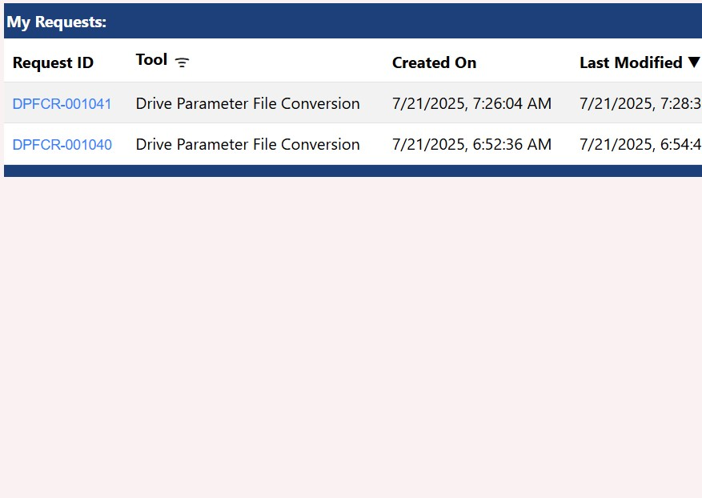
PowerFlex Drive Conversion Tool
Past Requests
Upload the original drive configuration
Up to 15 drive configuration files may be uploaded at once
For PowerFlex 700 with Vector Control, users can select if they need to include I/O option card and/or Encoder option card
View the status of past requests

Slide 5
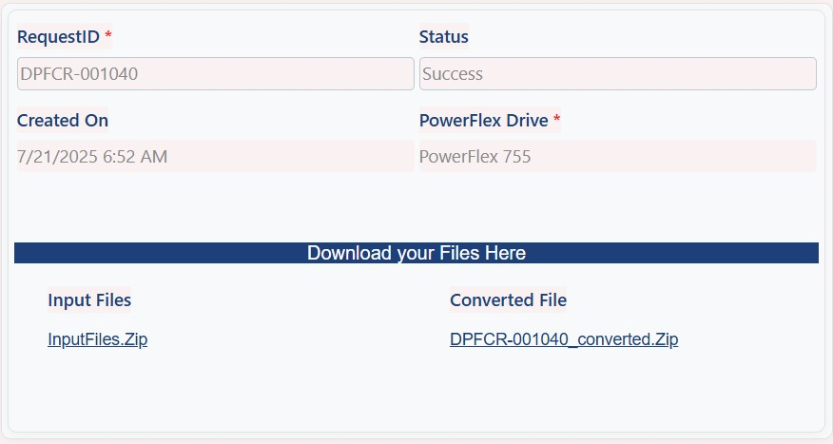
PowerFlex Drive Conversion Tool
Downloading
Upload the original drive configuration
Up to 15 drive configuration files may be uploaded at once
For PowerFlex 700 with Vector Control, users can select if they need to include I/O option card and/or Encoder option card
View the status of past requests
Download corresponding .zip folder containing
Converted PowerFlex 755TS configuration file (.iuux)
Summary log file (.csv)

Slide 6
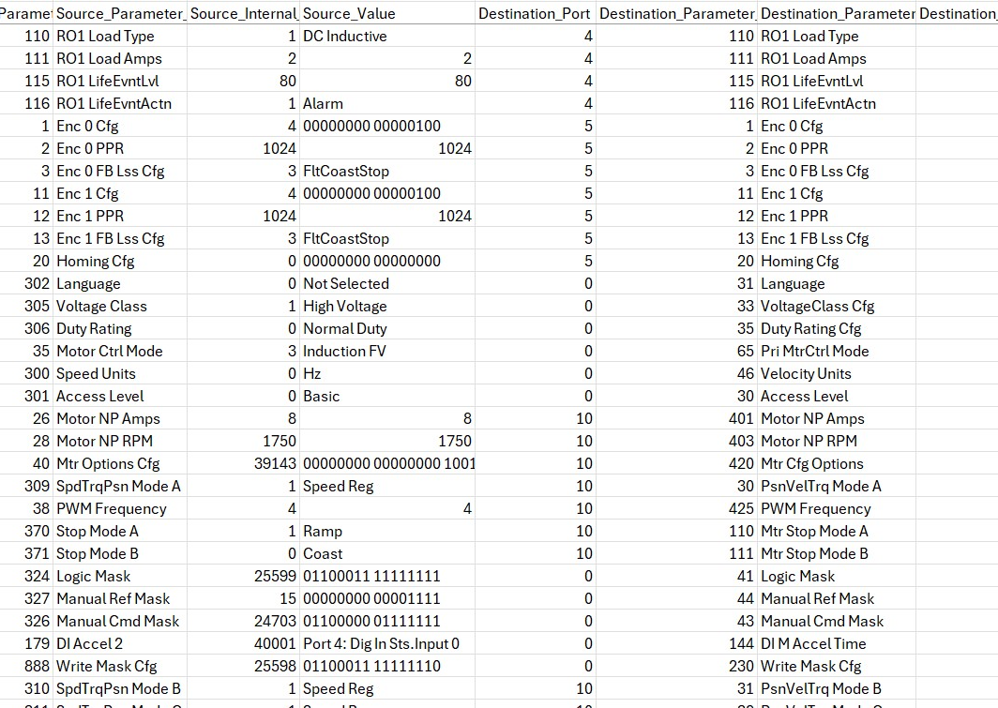
PowerFlex Drive Conversion Tool
Summary Log File
Informational only, not required to configure
Log file terminology
Source: Original Drive
Destination: PowerFlex 755TS
The log file includes
Source Rating Code and Destination Rating Code
Conversion Type (Frame Rating, Parameter Conversion, Peripheral Conversion)
Port and Parameter Numbers for the Source and the Destination
Values of the converted parameters
Reasons for not converting certain parameters

Slide 7
PowerFlex Drive Conversion Tool
Prerequisites
Connected Components Workbench v21+
Microsoft Excel (or similar application) if desiring to view .csv log files

Slide 8
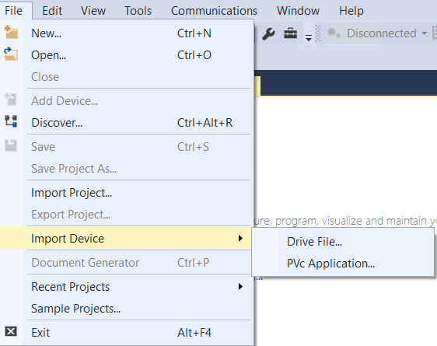
PowerFlex Drive Conversion Tool
How to?
Open Connected Components Workbench
Import Device using the PowerFlex 755TS drive file that was generated by the Conversion Tool

Slide 9
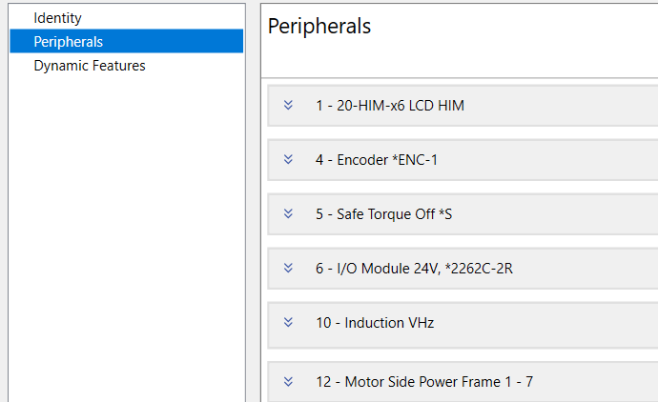
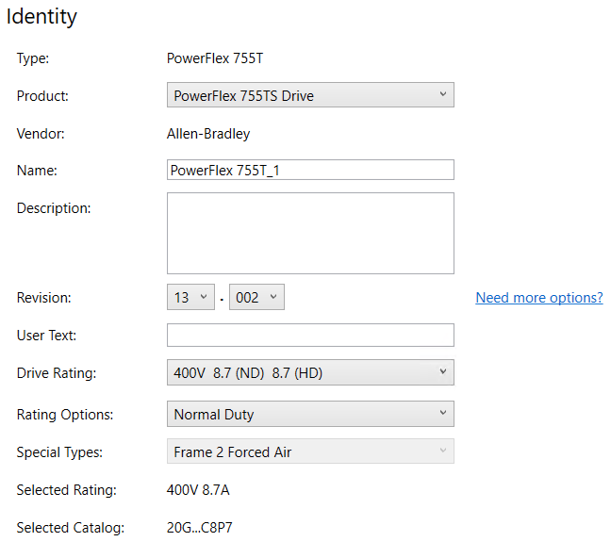
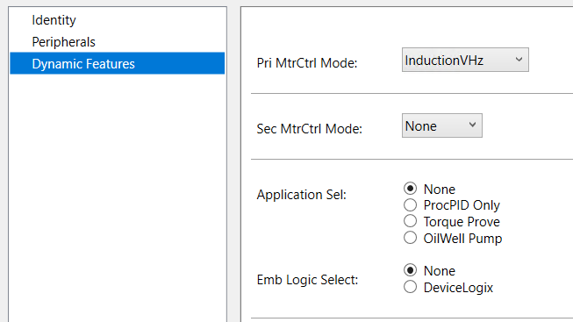
PowerFlex Drive Conversion Tool
How to?
See that the drive ratings are correct and select the desired firmware revision
Note the peripherals and dynamic features have been set automatically

Slide 10
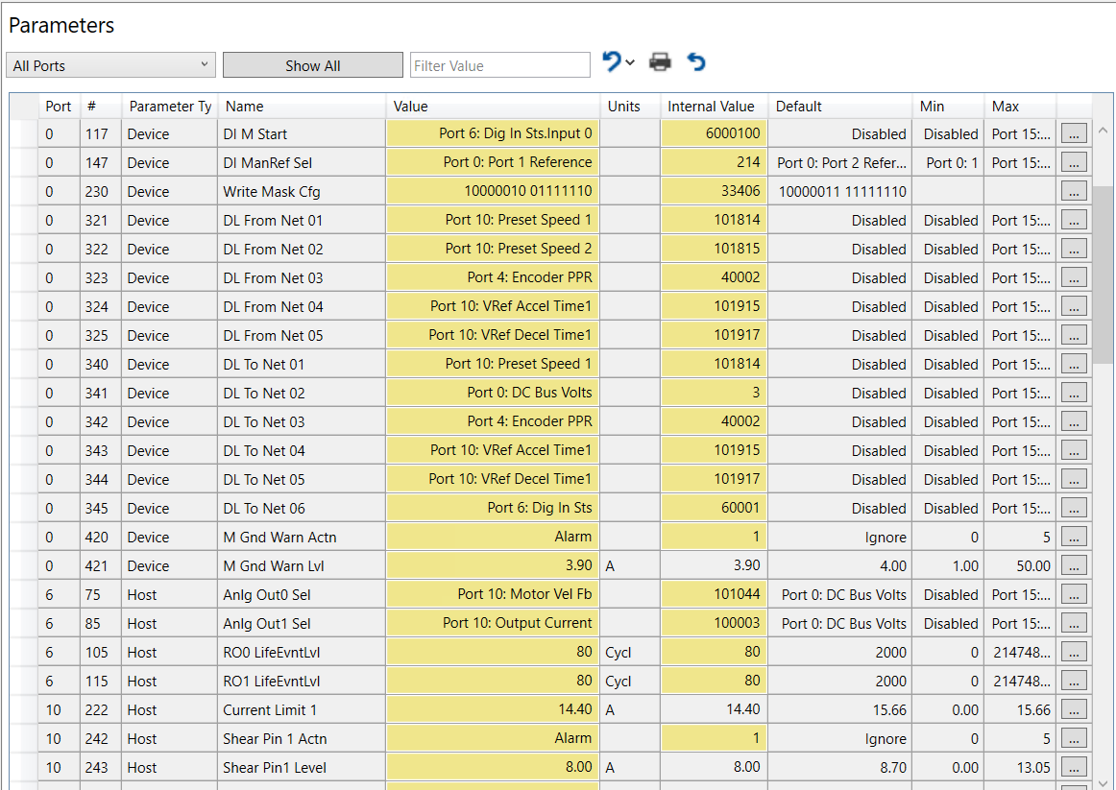
PowerFlex Drive Conversion Tool
How to?
Open the parameters and select Show Non-Defaults to see the parameters that were set during the conversion

Slide 11
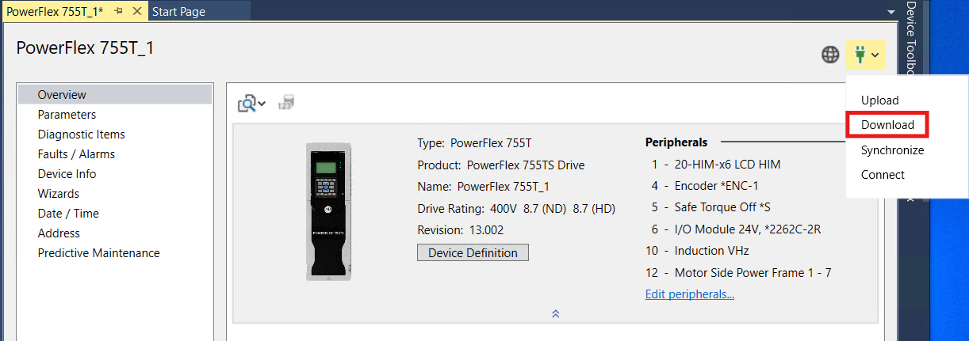
PowerFlex Drive Conversion Tool
How to?
Download the configuration file to the PowerFlex 755TS

Slide 13
PowerFlex Drive Conversion Tool
Planned Future Features
PowerFlex 700S Phase II Support Frames 1-7
208V/240V 2.2A-260A
400V/480V 1.1A-481A
600V 1.7A-261A
690V 52A-142A
Multi-language support
English, German, French, Italian, Spanish, Chinese
User selection of PowerFlex 755TS Firmware Revision
Selection to be made from within the PowerFlex Drive Conversion Tool
Improved handling of Process PID and Torque Proving Dynamic Feature Selection

